Slide 1
HOW I DID THE CLEANING PROCESS

Slide 2
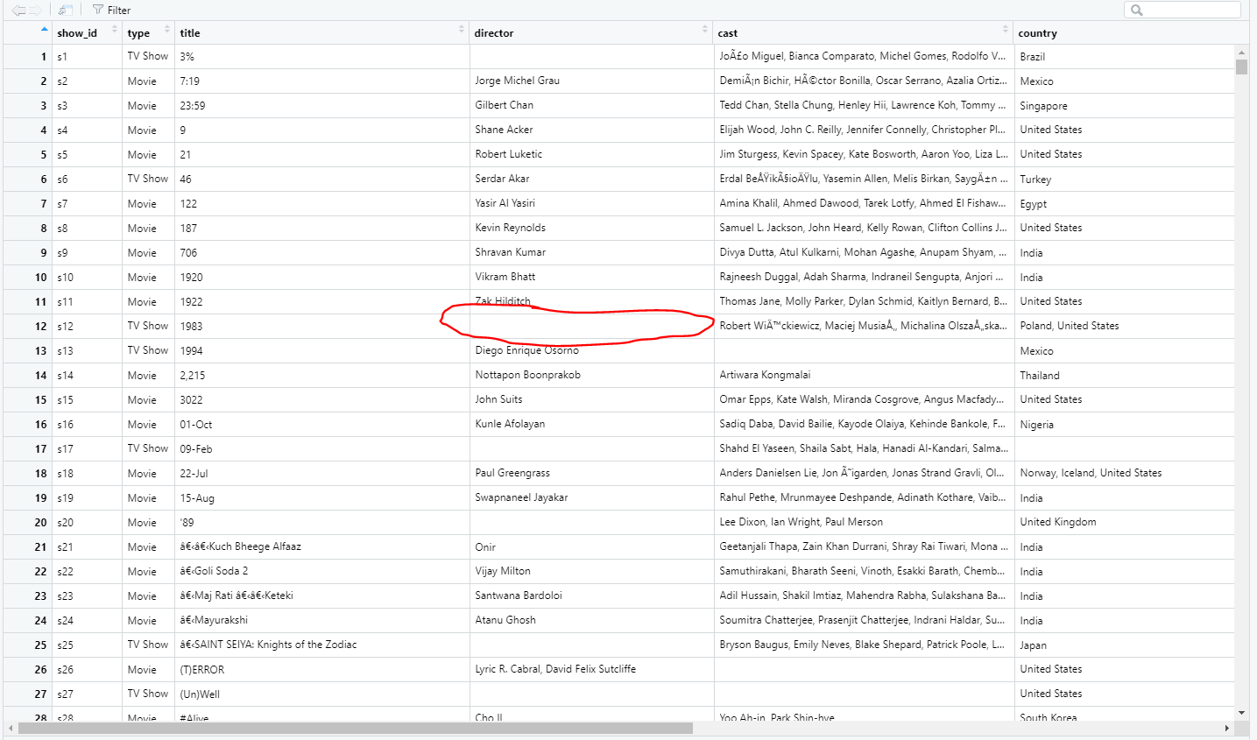
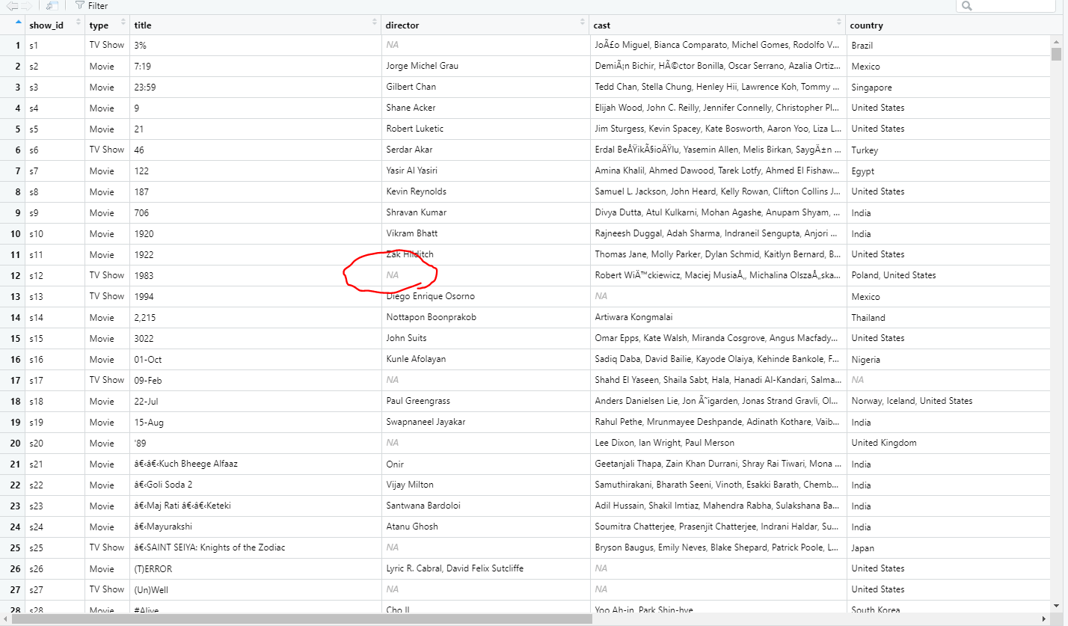
STEP 1: Dealing with the blanks
Convert the blank entries into a NULL value as a placeholder
In R, it’s NaN …. Don’t know what that is in Python
netflix = netflix %>% mutate_all(na_if, "")

Slide 3
STEP 2A: Filling those blanks – Content Ratings
There were 7 rows with missing content ratings. I just filled it out manually via Google Search
netflix = netflix %>%
mutate(
rating =
ifelse(c(is.na(rating) & title == "13TH: A Conversation with Oprah Winfrey & Ava DuVernay"), "TV-PG",
ifelse(c(is.na(rating) & title == "My Honor Was Loyalty"), 'PG-13',
ifelse(c(is.na(rating) & title == "Gargantia on the Verdurous Planet"), "TV-14",
ifelse(c(is.na(rating) & title == "Little Lunch"), "TV-Y7",
ifelse(c(is.na(rating) & title == "Louis C.K.: Live at the Comedy Store"), "TV-MA",
ifelse(c(is.na(rating) & title == "Louis C.K.: Hilarious"), "TV-MA",
ifelse(c(is.na(rating) & title == "Louis C.K. 2017"), "TV-MA", rating)))))))
)

Slide 4
STEP 2B: Filling those blanks – Country
There are several hundred – thousands rows with missing country
Solution to maintain as much data as possible: Multi-step imputation utilizing existing data in the data set
1) Use the “listed_in” section to search for ways to input country…namely those listing Korean TV Shows and British TV Shows
netflix = netflix %>%
mutate(
country = ifelse(c(is.na(country) & (str_detect(listed_in, "[Kk]orea") == TRUE)), "South Korea",
ifelse(c(is.na(country) & (str_detect(listed_in, "[Bb]ritish") == TRUE)), "United Kingdom", country))
)

Slide 5
STEP 2B: Filling those blanks – Country
2) Use some keywords in the Title to help figure out country of origin (i.e., if it mentions “Hindi”, pretty confident we’re talking about India)…use Google for help
netflix = netflix %>%
mutate(country =
ifelse(c(is.na(country) & str_detect(title, "[Hh]indi") == T), "India",
ifelse(c(is.na(country) & str_detect(title, "[Tt]amil") == T), "India",
ifelse(c(is.na(country) & str_detect(title, "Power Rangers Super Megaforce") == T), "United States",
ifelse(c(is.na(country) & str_detect(title, "Power Rangers Super Samurai") == T), "United States",
ifelse(c(is.na(country) & str_detect(title, "Trailer Park Boys: Out of the Park: USA") == T), "United States",
ifelse(c(is.na(country) & str_detect(title, "The Naked Gun 2 1/2: The Smell of Fear") == T), "United States",
ifelse(c(is.na(country) & str_detect(title, "Power Rangers ") == T), "United States",
ifelse(c(is.na(country) & str_detect(title, "Monty Python") == T), "United Kingdom",
ifelse(c(is.na(country) & str_detect(title, "Calico Critters") == T), "United States",
ifelse(c(is.na(country) & str_detect(title, "ChuChuTV") == T), "India",
ifelse(c(is.na(country) & str_detect(title, "ChuChu TV") == T), "India",
ifelse(c(is.na(country) & str_detect(title, "France") == T), "France",
ifelse(c(is.na(country) & str_detect(title, "The Birth Reborn") == T), "Brazil", country)))))))))))))
)

Slide 6
STEP 2B: Filling those blanks – Country
3) Use some of the names in the cast to help determine country of origin (i.e., if it mentions “Kevin Hart”, pretty confident we’re talking about USA)…use Google for help … will need to make a few of these!
netflix = netflix %>%
mutate(country =
ifelse(c(is.na(country) & str_detect(cast, "[Aa]oi") == T), "Japan",
ifelse(c(is.na(country) & str_detect(cast, "[Pp]atta.") == T), "Thailand",
ifelse(c(is.na(country) & str_detect(cast, "Jackson") == T), "United States",
ifelse(c(is.na(country) & str_detect(cast, "[Pp]rabh") == T), "India",
ifelse(c(is.na(country) & str_detect(cast, "[Yy]ama") == T), "Japan",
ifelse(c(is.na(country) & str_detect(cast, "Elyse Maloway") == T), "United States",
ifelse(c(is.na(country) & str_detect(cast, "Michela Luci") == T), "Canada",
ifelse(c(is.na(country) & str_detect(cast, "Singh") == T), "India",
ifelse(c(is.na(country) & str_detect(cast, "Arjun") == T), "India",
ifelse(c(is.na(country) & str_detect(cast, "[Hh]yun") == T), "South Korea",
ifelse(c(is.na(country) & str_detect(cast, "Frank Grillo") == T), "United States",
ifelse(c(is.na(country) & str_detect(cast, "Fred Armisen") == T), "United States",
ifelse(c(is.na(country) & str_detect(cast, "Chris Rock") == T), "United States",
ifelse(c(is.na(country) & str_detect(cast, "Kevin Hart") == T), "United States",
ifelse(c(is.na(country) & str_detect(cast, "Oprah Winfrey") == T), "United States",
ifelse(c(is.na(country) & str_detect(cast, "Quincy Jones") == T), "United States",
ifelse(c(is.na(country) & str_detect(cast, "Iliza Shlesinger") == T), "United States",
ifelse(c(is.na(country) & str_detect(cast, "Bert Kreischer") == T), "United States",
ifelse(c(is.na(country) & str_detect(cast, "Killer Mike") == T), "United States",
ifelse(c(is.na(country) & str_detect(cast, "Stephen Fry") == T), "United Kingdom",
ifelse(c(is.na(country) & str_detect(cast, "[Rr]yoko") == T), "Japan", country)))))))))))))))))))))
)

Slide 7
STEP 2B: Filling those blanks – Country
4) Leverage key words in the description that mentioned a specific country to help with establishing a particular country.
netflix= netflix %>%
mutate(
country =
ifelse(c(is.na(country) & str_detect(description, "Polish") == T), "Poland",
ifelse(c(is.na(country) & str_detect(description, "Kuala") == T), "Malaysia",
ifelse(c(is.na(country) & str_detect(description, "French") == T), "France",
ifelse(c(is.na(country) & str_detect(description, "[Mm]exican") == T), "Mexico",
ifelse(c(is.na(country) & str_detect(description, "Japan's top male") == T), "Japan",
ifelse(c(is.na(country) & str_detect(description, "Brazilian") == T), "Brazil", country))))))
)

Slide 8
STEP 2B: Filling those blanks – Country
5) For the rest of the missing countries, just list it as “Unknown”
netflix = netflix %>% mutate(country = ifelse(is.na(country), "Unknown", country))

Slide 9
STEP 3: Filling those blanks – Cast & Director
I didn’t want to do the process of Googling everything, plus there’s no conceivable way to figure the imputation on missing cast/director via existing variables… just list it as “unknown cast” or “unknown director”
netflix = netflix %>%
mutate(
director = ifelse(is.na(director), "Unknown/No Director(s)", director),
cast = ifelse(is.na(cast), "Unknown/No Cast", cast)
)

Slide 10
STEP 4: Dealing with the formatting of date added
Like I can’t imagine this being a viable factor in anything, but if you want to, you’ll need reformat about 70~ish rows since I believe the updated entries are just not consistent with previous entries.
netflix = netflix %>%
mutate(date_added =
ifelse(date_added == " August 4, 2017", "04-Aug-17",
ifelse(date_added == " December 23, 2018", "23-Dec-18",
ifelse(date_added == " December 15, 2018", "15-Dec-18",
ifelse(date_added == " July 1, 2017", "01-Jul-17",
ifelse(date_added == " July 26, 2019", "26-Jul-19",
ifelse(date_added == " May 26, 2016", "26-May-16",
ifelse(date_added == " November 1, 2019", "01-Nov-19",
ifelse(date_added == " December 2, 2017", "2-Dec-17",
ifelse(date_added == " March 15, 2019", "15-Mar-19",
ifelse(date_added == " October 1, 2019", "01-Oct-19",
ifelse(date_added == " December 15, 2017", "15-Dec-17",
ifelse(date_added == " July 1, 2017", "01-Jul-17",
ifelse(date_added == " August 4, 2017", "04-Aug-17",
ifelse(date_added == " April 4, 2017", "04-Apr-17",
ifelse(date_added == " December 28, 2016", "28-Dec-16",
ifelse(date_added == " March 31, 2018", "31-Mar-18",
ifelse(date_added == " February 1, 2019", "01-Feb-19",
ifelse(date_added == " January 1, 2018", "01-Jan-18",
ifelse(date_added == " July 1, 2017", "01-Jul-17",
ifelse(date_added == " February 24, 2018", "24-Feb-18",
ifelse(date_added == " March 31, 2018", "31-Mar-18",
ifelse(date_added == " July 20, 2018", "20-Jul-18",
ifelse(date_added == " January 17, 2018", "17-Jan-18",
ifelse(date_added == " September 7, 2016", "07-Sep-18", date_added))))))))))))))))))))))))
)

Slide 11
STEP 5A: Splitting up the text – Cast & Director
Will need to split up the long string of text to individual columns. Good thing is that the FIRST LISTED NAME in cast/director correspond to headlining actor/actress or lead director vs. assistant director
netflix_director_split = netflix %>%
separate(
director, into = c("lead","assitant 1","assistant 2","assistant 3","assistant 4","assistant 5","assistant 6", "assistant 7","assistant 8","assistant 9","assistant 10","assistant 11","assistant 12"), sep = ", ") %>%
pivot_longer(lead:`assistant 12`, names_to = "director_type", values_to = "director_name") %>%
filter(!is.na(director_name)) %>%
mutate(director_type = ifelse(director_type != "lead", "assistant/guest", "lead"))
netflix_cast_split = netflix %>%
separate(
cast, into = c("headliner", 'cast member 1', 'cast member 2', 'cast member 3', 'cast member 4', 'cast member 5', 'cast member 6', 'cast member 7', 'cast member 8', 'cast member 9', 'cast member 10', 'cast member 11', 'cast member 12', 'cast member 13', 'cast member 14', 'cast member 15', 'cast member 16', 'cast member 17', 'cast member 18', 'cast member 19', 'cast member 20', 'cast member 21', 'cast member 22', 'cast member 23', 'cast member 24', 'cast member 25', ‘cast member 26', 'cast member 27', 'cast member 28', 'cast member 29', 'cast member 30', 'cast member 31', 'cast member 32', 'cast member 33', 'cast member 34', 'cast member 35', 'cast member 36', 'cast member 37', 'cast member 38', 'cast member 39', 'cast member 40', 'cast member 41', 'cast member 42', 'cast member 43', 'cast member 44', 'cast member 45', 'cast member 46', 'cast member 47', 'cast member 48', 'cast member 49'), sep = ", ") %>%
pivot_longer(headliner:`cast member 49`, names_to = "cast_type", values_to = 'cast') %>%
filter(!is.na(cast)) %>%
mutate(cast_type = ifelse(cast_type == "headliner", "headliner", "supporting cast"))

Slide 12
STEP 5B: Splitting up the text – Genre + Country
Similar to cast and director, do the same thing for genre & country. So this means that the FIRST LISTED ENTRY correspond to the principal genre or country.
netflix_genre_split = netflix %>%
separate(listed_in, into = c('principal', 'secondary', 'tertiary'), sep = ",") %>%
pivot_longer(principal:tertiary, names_to = "listing_type", values_to = "genre") %>%
filter(!is.na(genre)) %>%
mutate(listing_type = ifelse(listing_type == "principal", "principal", 'secondary/tertiary'))
netflix_country_split = netflix %>%
separate(
country, c("main country", "secondary country", 'tertiary country', 'fourth country', "fifth country", 'sixth country', "seventh country", 'eighth country', 'nineth country', 'tenth country', 'eleventh country', 'twelfth country'), sep = ",") %>%
pivot_longer(`main country`:`twelfth country`, names_to = "country_type", values_to = "country_name") %>%
filter(!is.na(country_name)) %>%
mutate(
country_type = ifelse(country_type == "main country", 'main country', 'other country'),
country_name = ifelse(country_name == "", "Unknown Country", country_name)
)

Slide 13
STEP 6: Getting rid of all of the whitespace from splitting text
Not sure if it’s an issue with Python, but after splitting some text, there may be some extra space that shouldn’t be there….so just trim it off.
Bigger issue with Genre and Country than with cast or director
netflix_genre_split$genre = str_trim(netflix_genre_split$genre, side = 'both'
netflix_country_split$country_name = str_trim(netflix_country_split$country_name, side = 'both')

Slide 14
STEP 7: Getting keywords from the description
Since the description has a bunch of useless words that add no value to context other than grammatically, need to filter them out along with any grammatical symbols and punctuation marks.
Replacing non-ASCII characters with ASCII equivalents
Remove extra whitespace resulting from the split
netflix_description = netflix %>% mutate(description = gsub('[\\,.;:!?"]', "", description))
netflix_description = netflix_description %>% mutate(description = stringi::stri_trans_general(description, "latin-ascii"))
netflix_description$original_description = netflix_description$description
netflix_description = netflix_description %>% unnest_tokens(output = word, input = description) %>% anti_join(stop_words, by = "word")
netflix_description$keywords = str_trim(netflix_description$keywords, side = 'both')

Slide 15
STEP 8: Creating Multiple Data Sets
I created multiple data sets that expanded upon each variable for comparison
There are like 11 different kinds of data set I made:
Keywords x Genre
Keywords x Language
Director x Cast
Director x Language
Director x Genre
Cast x Language
Cast x Genre
Language x Genre
Director x Cast x Language
Director x Language x Genre
Cast x Language x Director x Genre

